Slide 1
embedded systems
FreeRTOS
Part 3: Memory usage

Slide 2

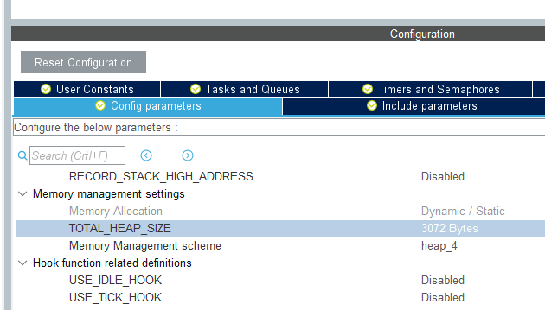
Memory usage
Memory is limited on embedded devices
So we must be careful with allocating memory
Memory is allocated on the heap
Size of the FreeRTOS heap defined by
configTOTAL_HEAP_SIZE in FreeRTOSConfig.h
Or in STM32CubeMX

Slide 3
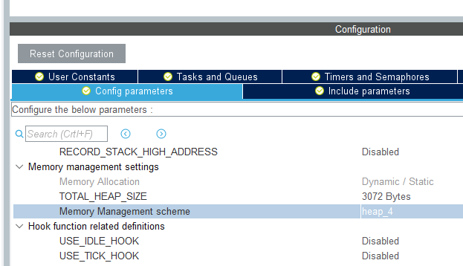

Handling the heap
or in CubeMX
In FreeRTOSConfig.h
In FreeRTOS, the heap can be handled in 5 ways:
heap_1
simplest, does not permit memory to be freed
heap_2
permits memory to be freed, but does not combine adjacent free blocks
heap_3
simply wraps the standard malloc() and free() for thread safety
heap_4
combines adjacent free blocks to avoid fragmentation
includes absolute address placement option
heap_5
as heap_4, but can span the heap across multiple non-adjacent memory areas
Best use his one
For more details, see here

Slide 4
Note about heaps
Be aware that there are 2 heaps
The FreeRTOS heap
For objects created, or memory allocated in FreeRTOS
osMutexNew → osMutexDelete
osThreadNew → osThreadTerminate/osThreadExit
The C/C++ heap
For standard malloc/free and C++ objects

Slide 5
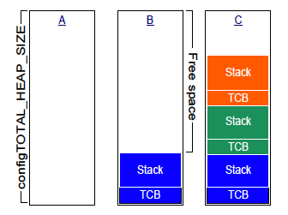
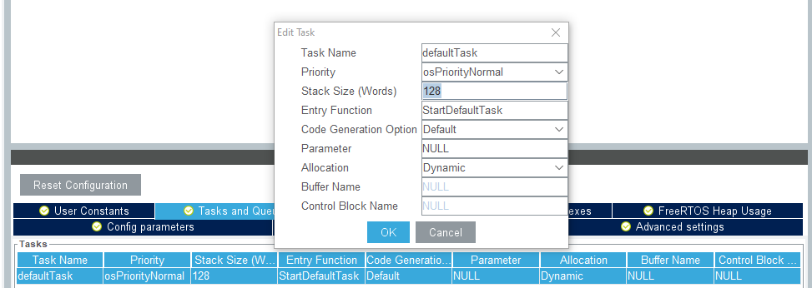
Thread specifics
Each thread uses 2 pieces of memory in the heap:
A Thread Control Block:
Around 92 bytes
Exact size depends on the configuration
A Stack: user defined in thread attributes
Used for function calls

Slide 6
Terminating a thread
When a thread must be ended, use osThreadTerminate or osThreadExit
If one thread terminates another thread → TCB and stack of terminated thread are released immediately
If a thread terminates itself → it will be added to a waiting list; → TCB and stack of terminated thread will be released by the Idle Thread
Important consequence:
If a thread terminates itself, and the Idle Thread never has a chance to run, then the TCB and stack will not be released

Slide 7
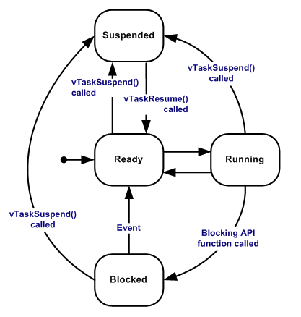
Idle Thread
This is a thread with the lowest priority
Will only run if
There are no other threads, or
All other threads are Blocked or Suspended
Consequently:
if there is at least one other thread Running or Ready, the Idle Thread will not run
The Idle Thread
Checks for terminated threads: prvCheckTasksWaitingTermination
Cleans up TCB/Stack for each of these threads: prvDeleteTCB
For more details: https://www.programmersought.com/article/4076625059/

Slide 8
Blocking functions
In a Blocking function
A thread might have to wait for something
While it is waiting
It is in the Blocked state (so not Ready or Running)
It does not use any CPU time
Only when all threads are Blocked, then the Idle Thread can run
Examples:
osDelay
osMutexAcquire
…

Slide 9
Busy waiting
In a busy wait function
A thread also might have to wait for something
While it is waiting
It is executing code
Continuously switching between Ready ↔ Running
Lower priority threads can never run
If there is just one thread busy waiting, then the Idle Thread can not run
Example: in function HAL_UART_Receive, we wait for a flag to be set:
while(__HAL_UART_GET_FLAG(huart, Flag) == RESET) { … }

Slide 10
osDelay
How is function osDelay(1000) implemented in v2?
Please note:
In v2 this will wait for 1000 timerticks
In v1, this will wait for 1000 msec
It is calling FreeRTOS function vTaskDelay
vTaskDelay puts the thread in the queue of Blocked threads
At every timertick, scheduler checks whether the thread has been waiting long enough
After the required number of timerticks, the thread goes back to the Ready state
Result: while waiting, the thread uses no CPU

Slide 11
HAL_Delay
How is function HAL_Delay(1000) implemented?
This is using busy waiting:
while((HAL_GetTick() - tickstart) < wait){}
Result: while waiting, the thread continuously uses CPU
osDelay and HAL_Delay can have very different effects on lower priority threads

